Slide 1
KNOWLEDGE CHIKUSE
Blockchain is using enough juice to power Joburg

Slide 2
A watt hour (Wh) is the amount of energy needed to run a 1W appliance for an hour

Slide 3
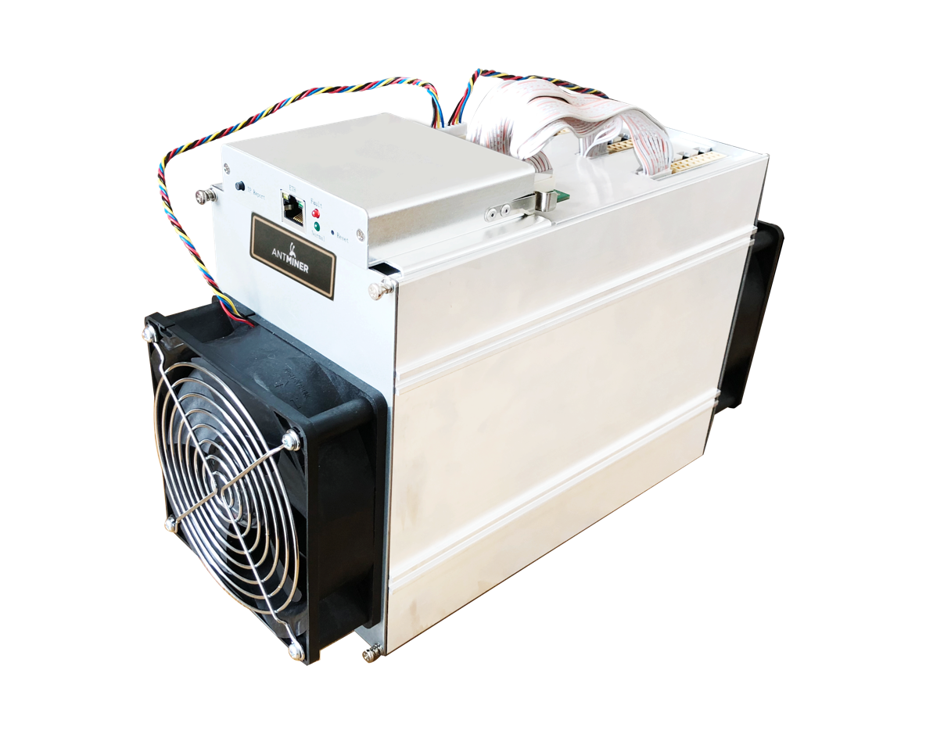
This is an Antminer X3.
It uses 550W

Slide 4
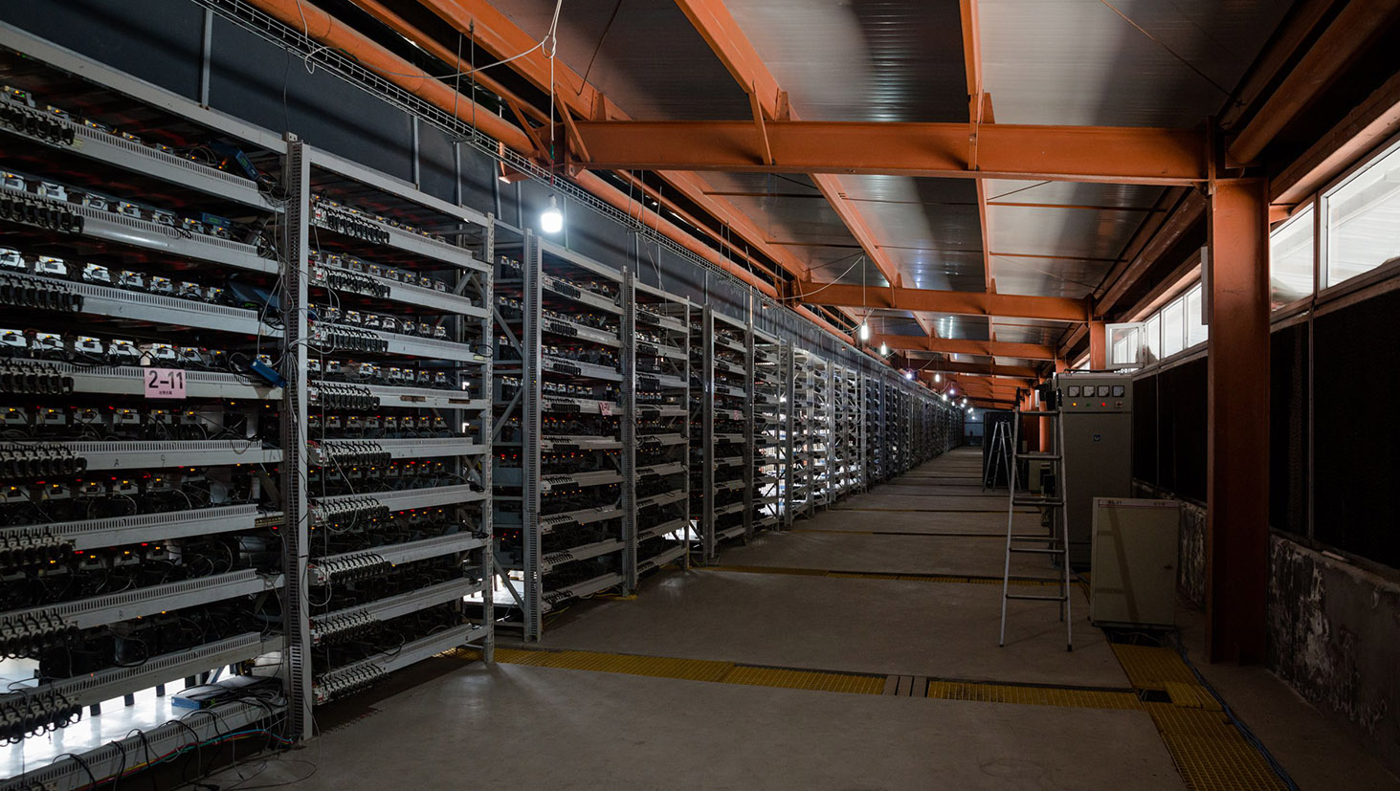
This is part of Chinese company Bitmain’s coal-powered farm in Mongolia, with 25,000 miners

Slide 5
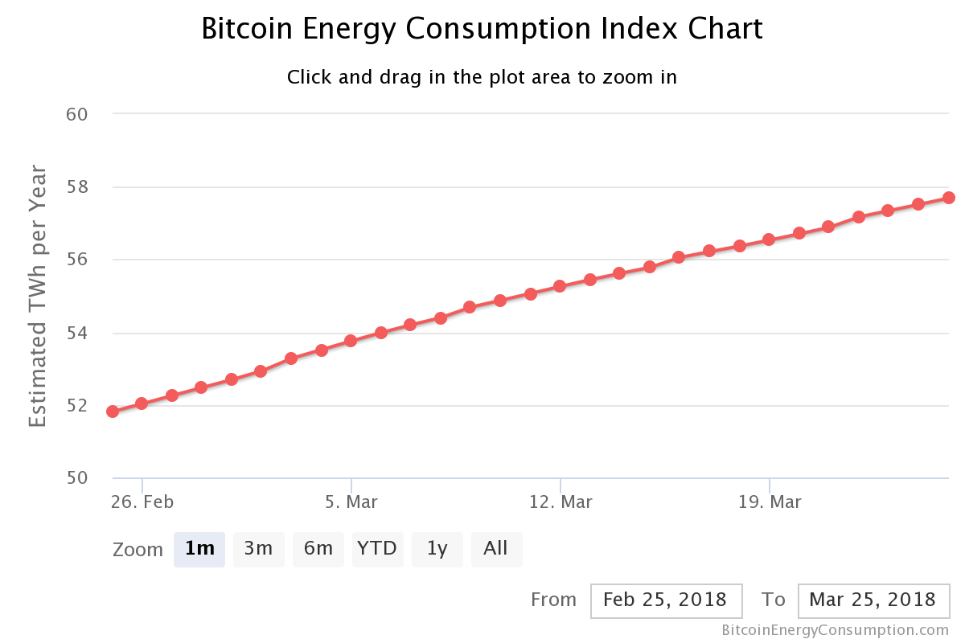
58TWh

Slide 6
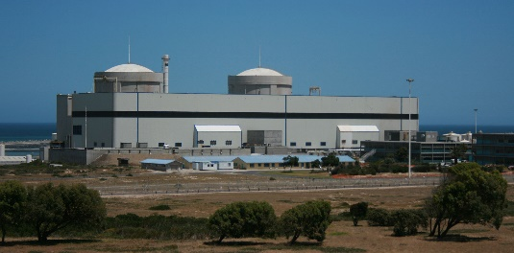
Koeberg Nuclear Power Station (annual output of 14GWh)
x 4000

Slide 7

One transaction uses enough power to boil about 2000 litres of water (870kWh)

Slide 8
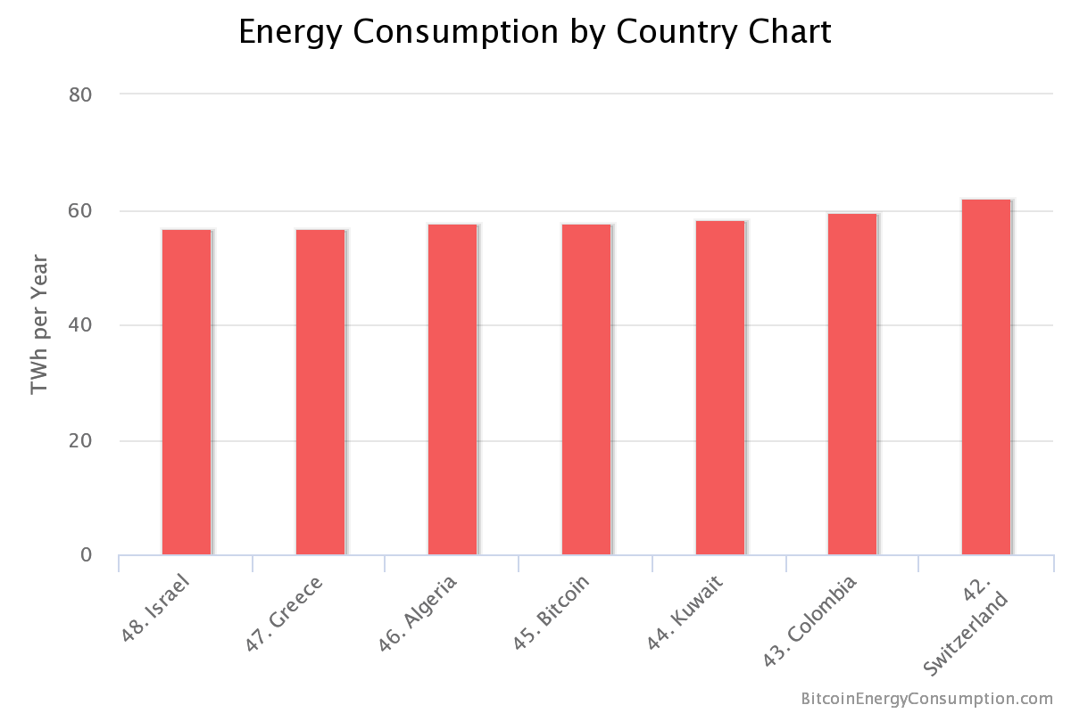

Slide 9
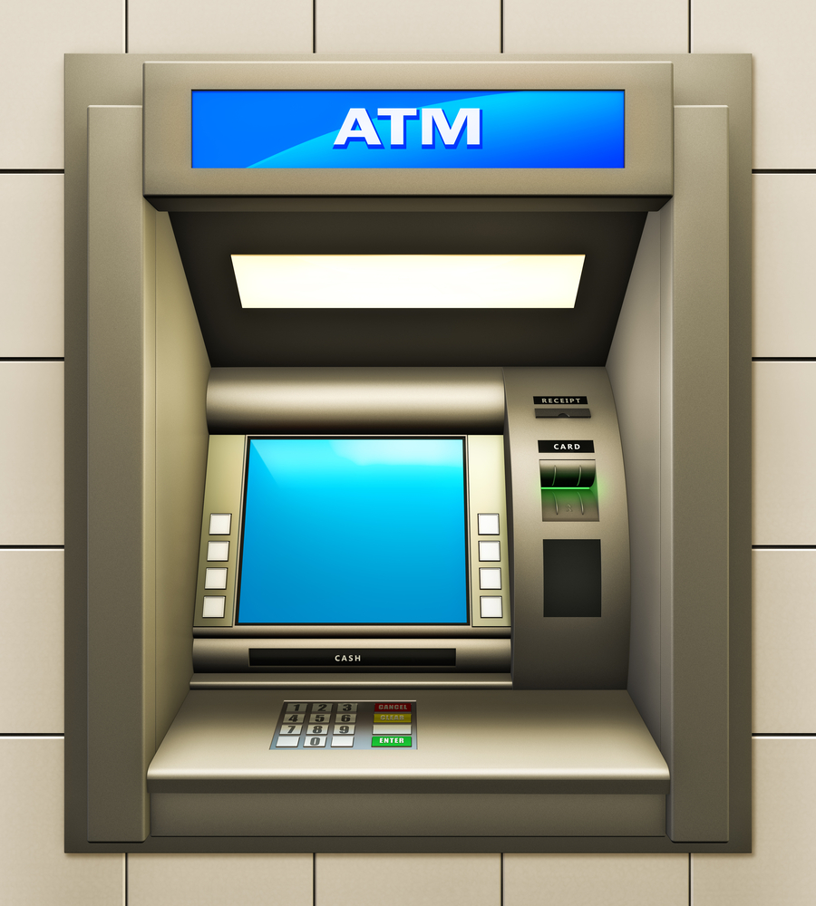
Of course our current banking system is not all that efficient either (ATMs, moving cash around, office aircon, servers….
about 70TWh

Slide 10
What’s the source of the problem?

Slide 11
/* THANK YOU*/
KNOWLEDGE CHIKUSE
DVT
kchikuse@jhb.dvt.co.za
@guruuswa
http://www.devconf.co.za/
https://bitcoin.org/bitcoin.pdf
https://digiconomist.net/bitcoin-energy-consumption
https://github.com/kchikuse/blockchain

